Slide 1
Classifying Internet Advertisements

Slide 2
SUMMARY
Detecting Advertisements on the Web
Internet Advertisements Data Set
ADEATER

Slide 3
Our Dataset
About a data that is advertisement or not
Generally included numerical instances
3279 Instances
1558 Attributes

Slide 4
Data Attributes
<A> tag
height , width , aspect ratio ,?
Local Attribute
>>Udest (a.host.com/…)
>>Uimg (b.host.com/…)
Instance's caption
Instance's alt text
Ubase,Udest,Uimg…

Slide 5
…19 caption features,111 alt features,495 base URL features, 472 destination URL features, and 457 image URL features.

Slide 6
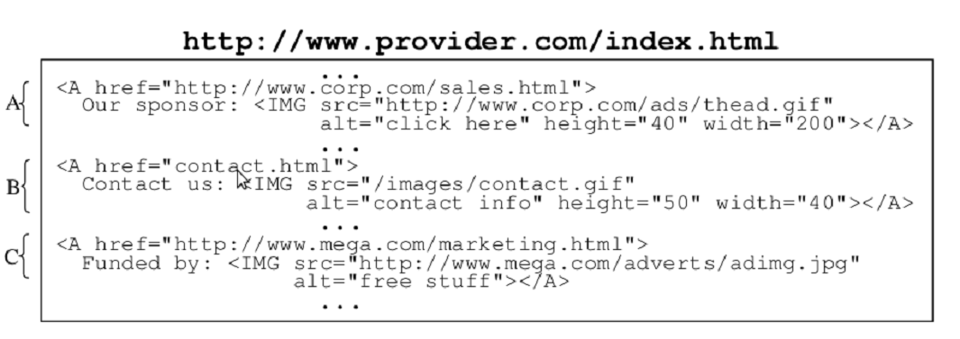
Example

Slide 8
Learning Rules
J48(C4.5) → Created 25 rules
Two representative examples are as follows:
>> If aspect ratio > 4.5833, alt doesn’t contain “to” but does contain “click+here”, and Udest doesn’t contain “http+www”, then instance is an AD.
>> H Ubase does not contain “messier”, and Udest contains the “redirect+cgi”, then instance is an AD.

Slide 9
Used Algoritms
J48 (C4.5) tree
Naive Bayes
Meta Attributes Selected
Random Tree
IBK

Slide 10
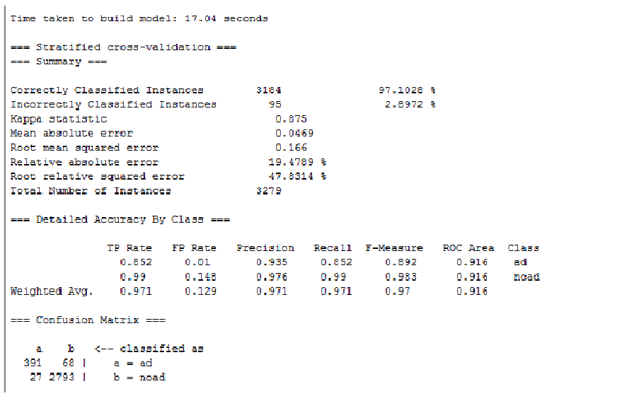
J48 --Cross Validation-10 fold

Slide 12
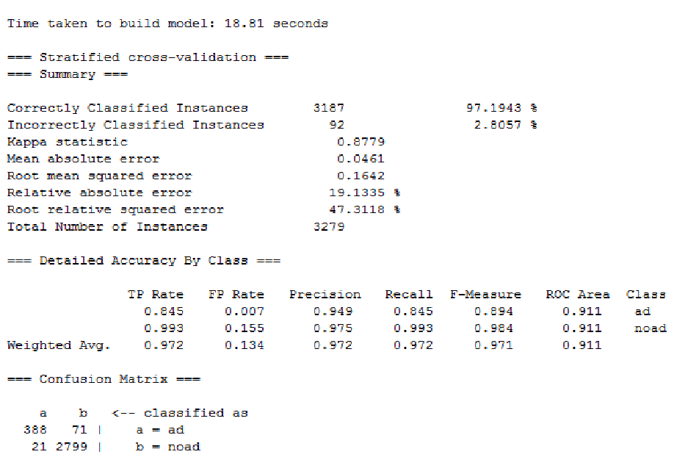
J48-Graft --Cross Validation-10 fold

Slide 13
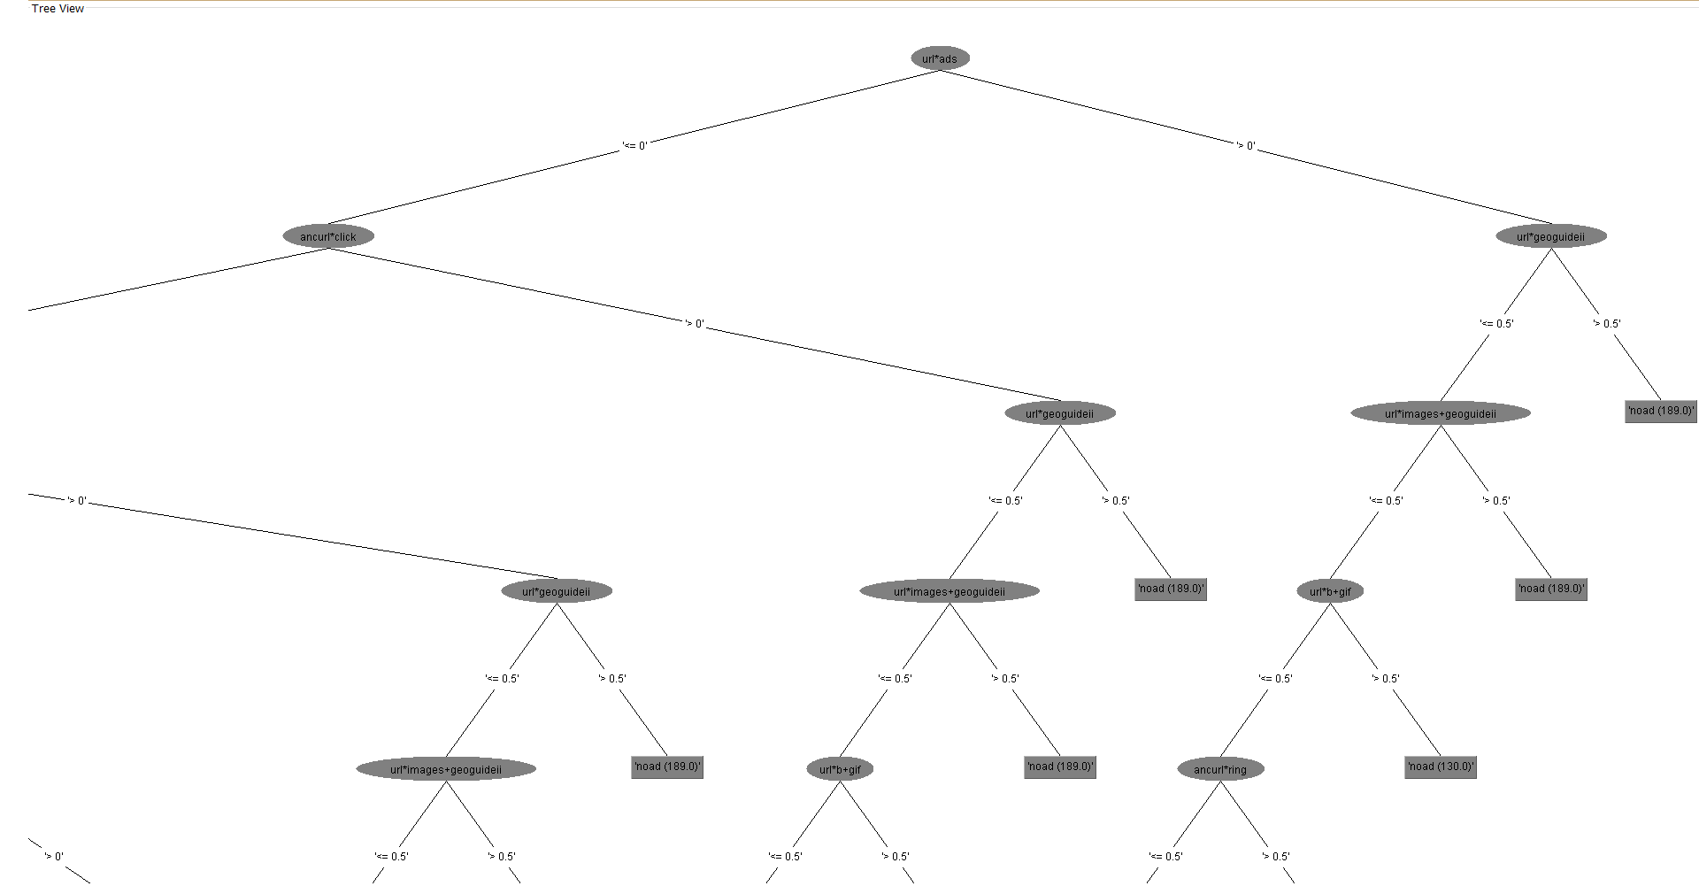

Slide 14
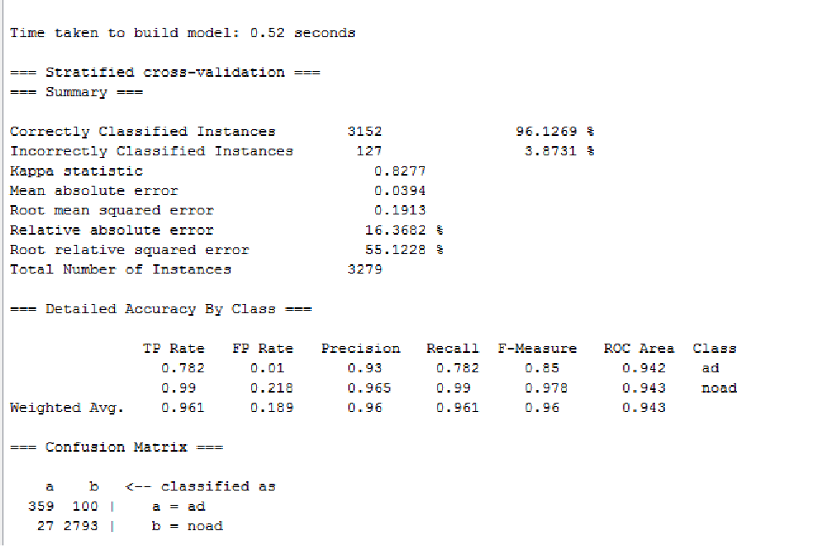
Naive Bayes --Cross Validation-10 fold

Slide 15
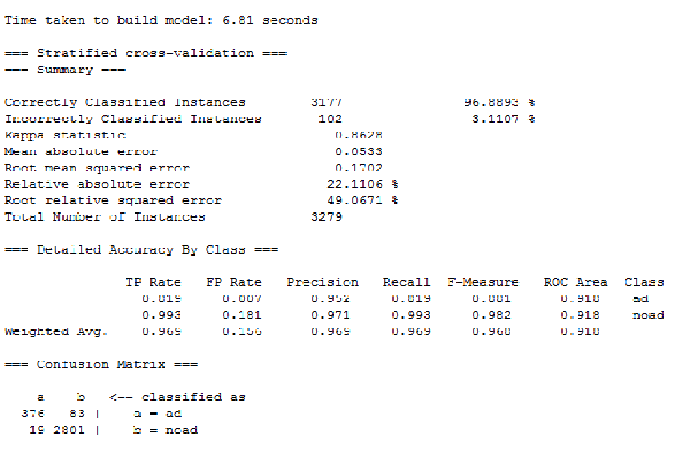
Meta Attribute Selected --Cross Validation-10 fold

Slide 16
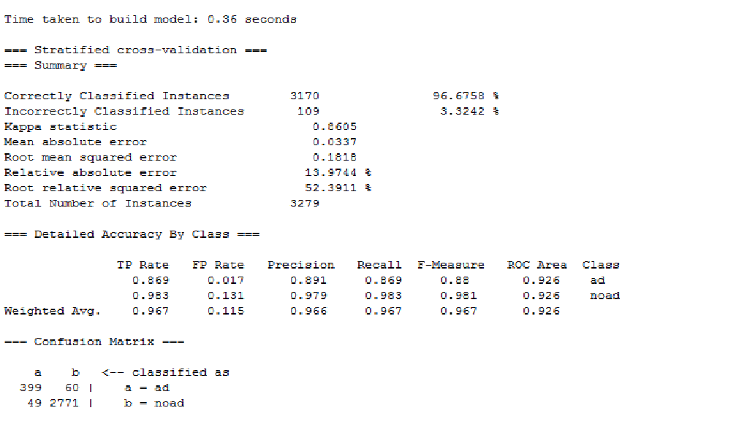
Random Tree --Cross Validation-10 fold

Slide 17
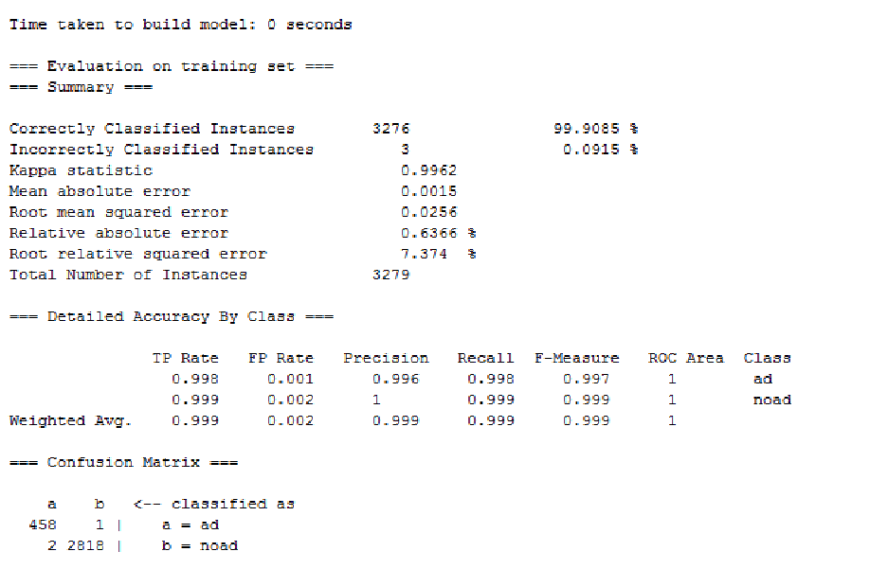
Ibk --Use training set

Slide 18
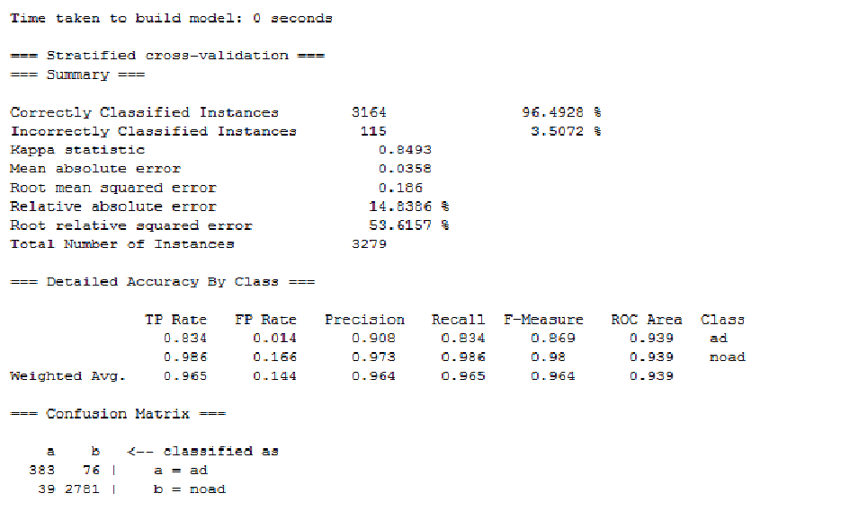
Ibk --Cross Validation-10 fold

Slide 19
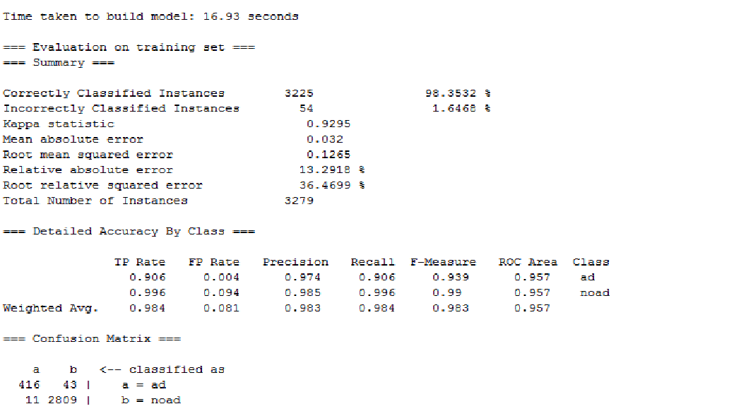
J48 --Use training set

Slide 20
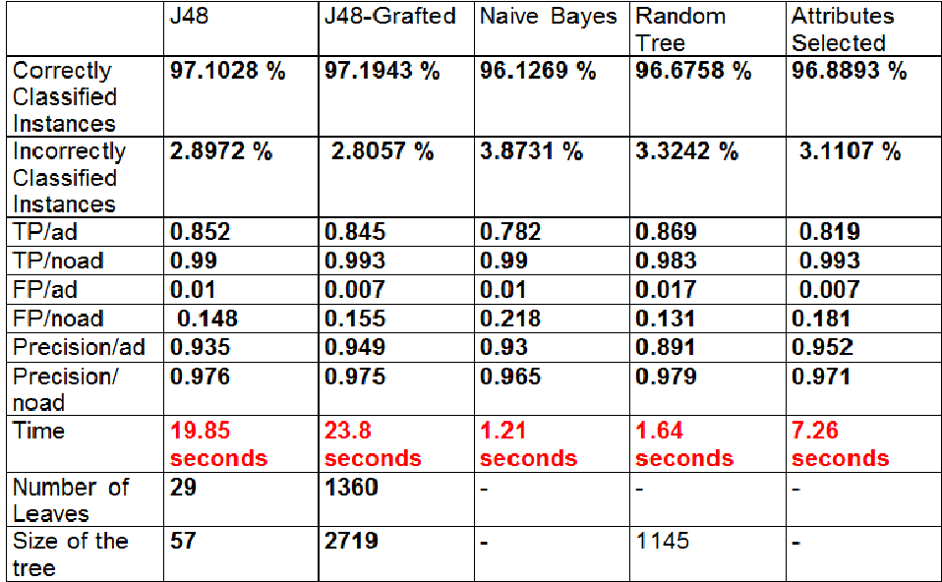
Conclusion

Slide 21
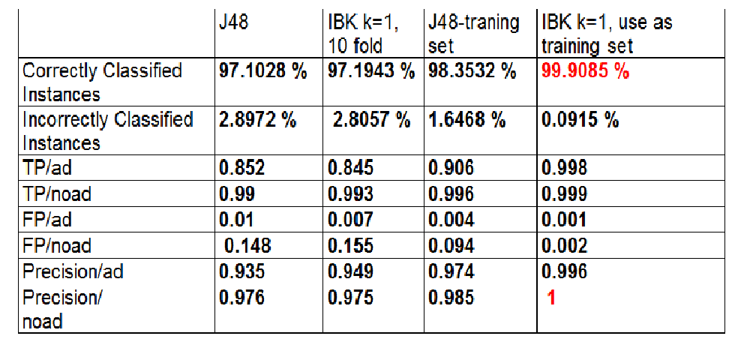

Slide 22
K fold Affects

